Slide 1
FORMAL LANGUAGES AND AUTOMATION THEORY
Lecture Notes #1
DFA and NFA

Slide 2

Introduction to Automata
• Automata theory is the study of abstract machines and computational problems.
• Automata are mathematical models of computation.
• They are used to understand what problems can be solved by computers.

Slide 3
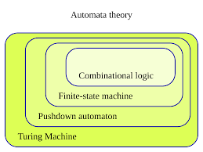
Types of Automata
• Finite Automata (FA)
• Pushdown Automata (PDA)
• Linear Bounded Automata (LBA)
• Turing Machine (TM)
Focus: Finite Automata (FA)

Slide 4
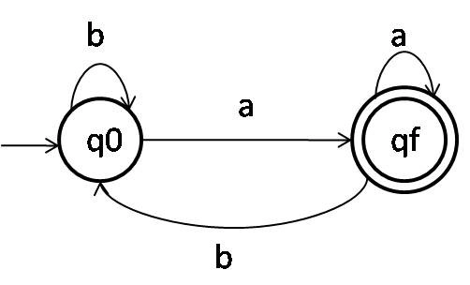
Deterministic Finite Automata (DFA)
• Each state has exactly one transition for each input symbol.
• No ambiguity in transitions.
• Formal definition: DFA = (Q, Σ, δ, q0, F)
- Q: Finite set of states
- Σ: Alphabet (input symbols)
- δ: Transition function
- q0: Start state
- F: Final states

Slide 5
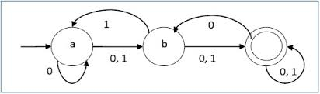
Non-Deterministic Finite Automata (NFA)
• A state can have multiple transitions for a single input symbol.
• May include ε (epsilon) transitions.
• Formal definition: NFA = (Q, Σ, δ, q0, F)
• NFAs and DFAs are equivalent in power.

Slide 6
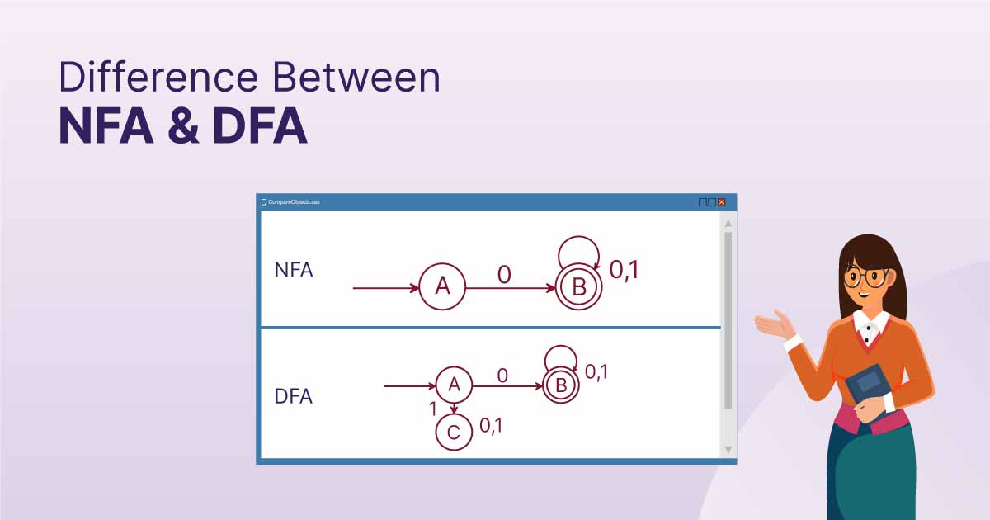
DFA vs NFA
• DFA: Exactly one path for each input string.
• NFA: Can have multiple paths for input string.
• DFA is easier to implement in HW/SW.
• NFAs are often simpler to design.
• Every NFA can be converted
into an equivalent DFA.

Slide 7
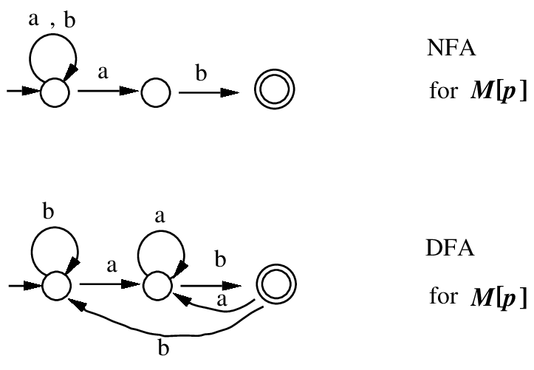
DFA vs NFA

Slide 8
DFA Example 1: Even Number of 0s
• Alphabet: {0, 1}
• Language: Strings with an even number of 0s
• States:
q0: Start state, even number of 0s (accepting)
q1: Odd number of 0s
• Transitions:
q0 --0--> q1, q1 --0--> q0
q0 --1--> q0, q1 --1--> q1

Slide 9
DFA Example 2: Strings Ending with 01
• Alphabet: {0, 1}
• Language: Strings that end with '01'
• States:
q0: Start state
q1: Last symbol was 0
q2: Last two symbols were 01 (accepting)
• Transitions:
q0 --0--> q1, q1 --1--> q2
q1 --0--> q1, q2 --0--> q1, q2 --1--> q0

Slide 10
NFA Example 1: Strings Ending with 1
• Alphabet: {0, 1}
• Language: Strings that end with '1'
• States:
q0: Start state
q1: Accepting state
• Transitions:
q0 --0--> q0, q0 --1--> q0
q0 --1--> q1 (non-deterministic choice)

Slide 11
NFA Example 2: Contains Substring 101
• Alphabet: {0, 1}
• Language: Strings that contain '101' as a substring
• States:
q0: Start state
q1: After reading '1'
q2: After reading '10'
q3: After reading '101' (accepting)
• Transitions:
q0 --1--> q1, q1 --0--> q2, q2 --1--> q3

Slide 12
Key Takeaways
• DFA examples: Even number of 0s, strings ending with 01
• NFA examples: Strings ending with 1, containing substring 101
• NFAs are simpler to design, DFAs easier to implement
• Both recognize the same class of regular languages

Slide 13
Applications of Automata
• Compiler design
• Text search
• Protocol design and verification
• Natural Language Processing (NLP)
• Artificial Intelligence (AI) models

Slide 14

Any Question??

